Slide 1
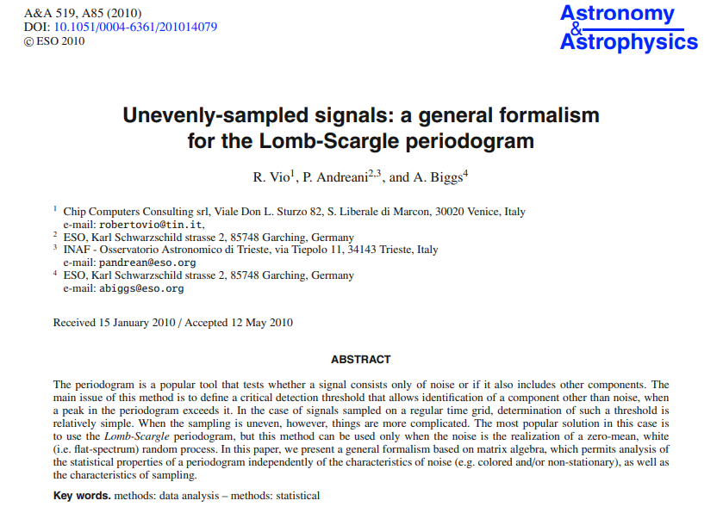
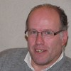
HOMEWORK 3
Correlated Noise LSP
Roberto Vio

